Slide 1
The AI Roadmap to Profitability
Predictive Break-Even Analysis for Smarter Financial Planning
Sanika Palaw
HBSU2324

Slide 2
Aims and Objectives
Master the core concepts of break-even analysis.
Understand the limitations of traditional, static models.
Explore AI & ML in financial forecasting.
Apply predictive insights for smart profitability planning

Slide 3
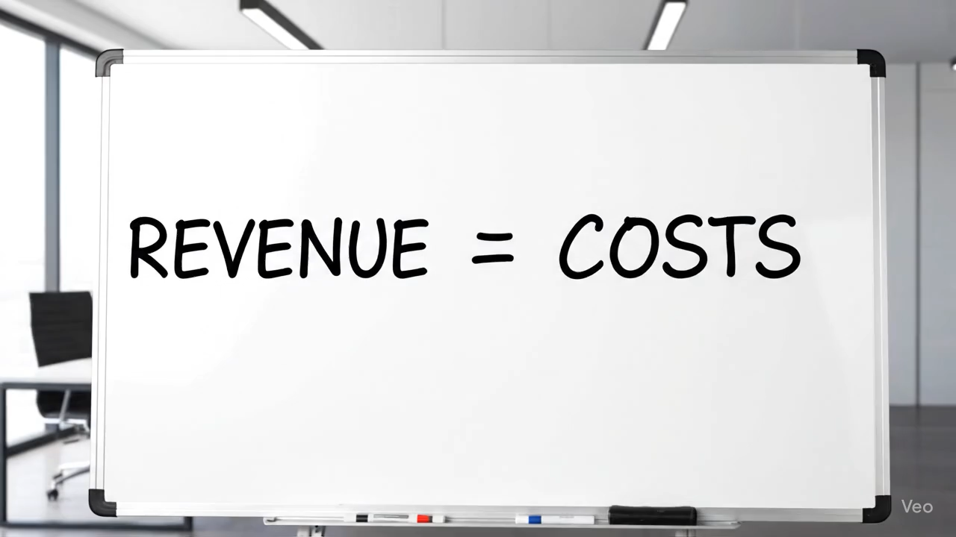
What is Break-Even Analysis?
The Point of Financial Equilibrium.
The break-even point is where a company's total revenue equals its total costs. At this point, the business is neither making a profit nor incurring a loss.

Slide 4
The Strategic Importance of Break-Even
A Reality Check for Your Business Model
Break-even analysis is a financial checkpoint that shows when a business will start making profit.
💡 Informed Decision-Making :
Guides pricing & production choices.
🎯 Goal Setting :
Sets clear sales benchmarks.
⚖ Risk Assessment :
Shows financial buffer before losses.
📊 Feasibility Studies : Strengthens business plans & investor trust.

Slide 5
Core Concepts: Know Your Costs
The Building Blocks for Our Model
🏠Fixed Costs (FC):
⚙️Variable Costs (VC):
📊Total Costs (TC):
Expenses that do not change with production or sales volume
Expenses that increase or decrease in direct proportion to production or sales.
The sum of fixed and variable costs, representing the overall cost of running the business.
Rent, insurance, permanent staff salaries
Raw materials, packaging, sales commissions
TC = FC + VC

Slide 6
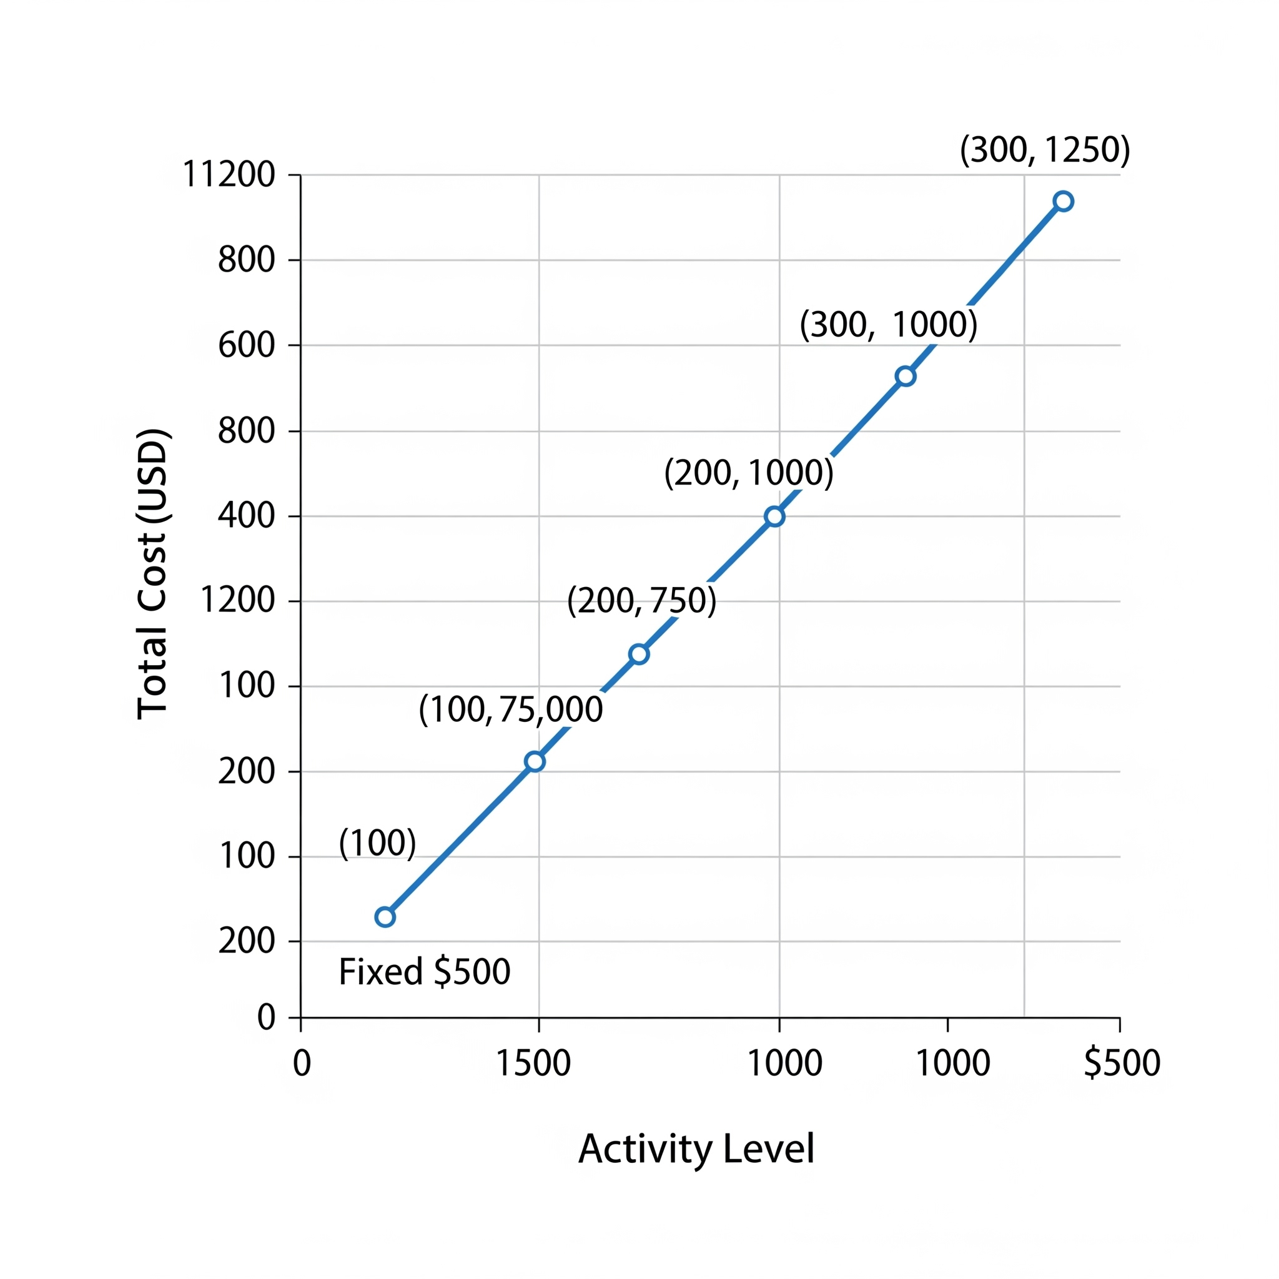
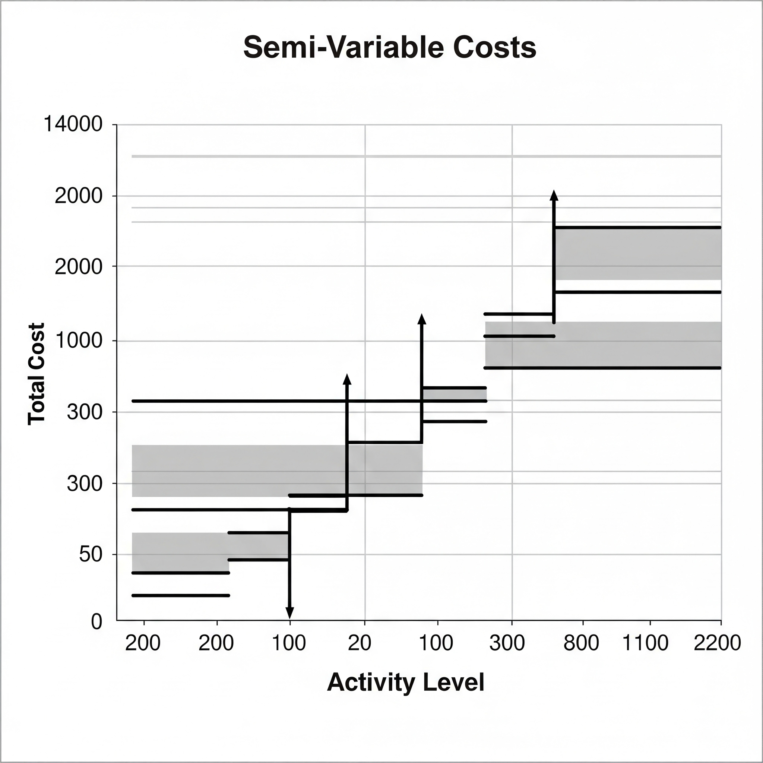
Understanding Cost Behavior
Beyond the Basics
Semi-Variable Costs 📊
Change in steps, not smoothly.
Example: Customer support staff added after 500 calls
Step-wise (staircase) behavior
Mixed Costs ⚙️
Fixed + variable components
Example: Warehouse rent + per-shipment cost
Starts at minimum cost, rises with activity

Slide 7
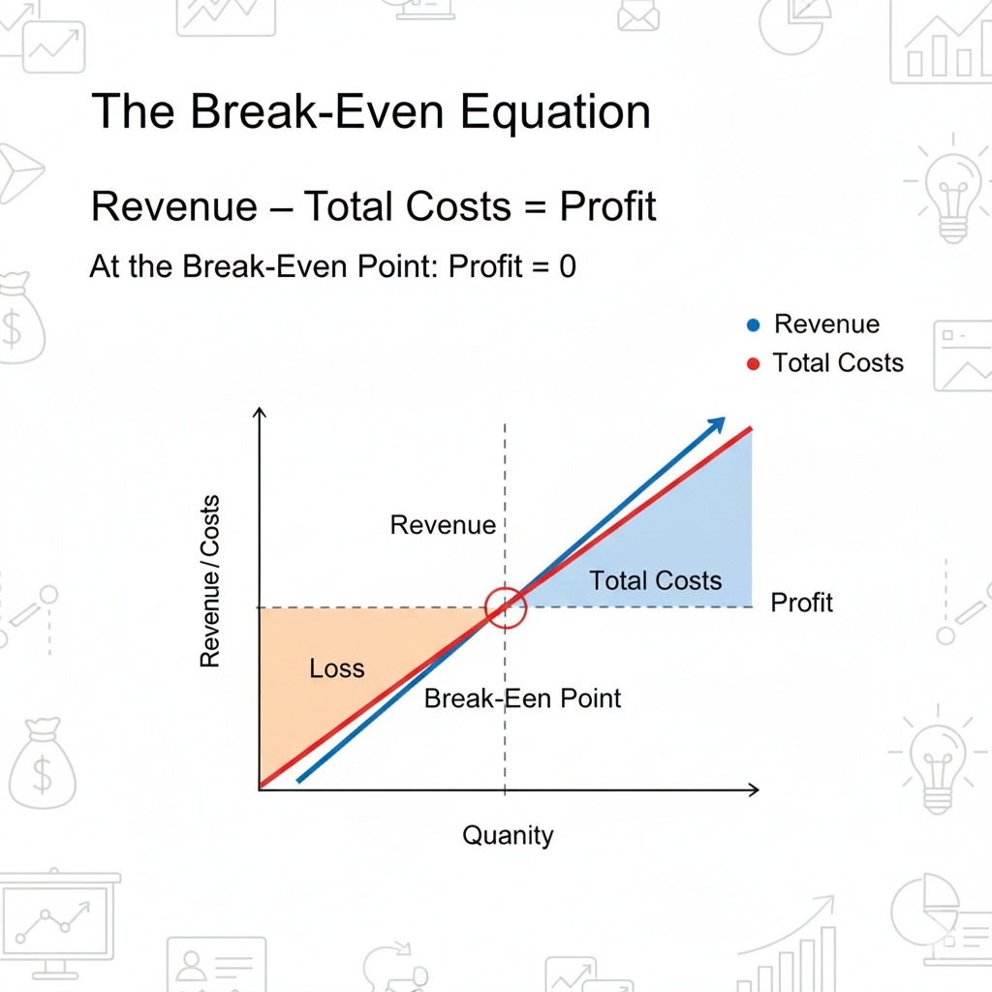

The Break-Even Equation
The Mathematical Model
Concept:
Break-even point occurs when Revenue = Total Costs.
At this point, Profit = 0
Helps firms determine minimum sales needed to cover costs
Useful for pricing,planning and decision-making

Slide 8
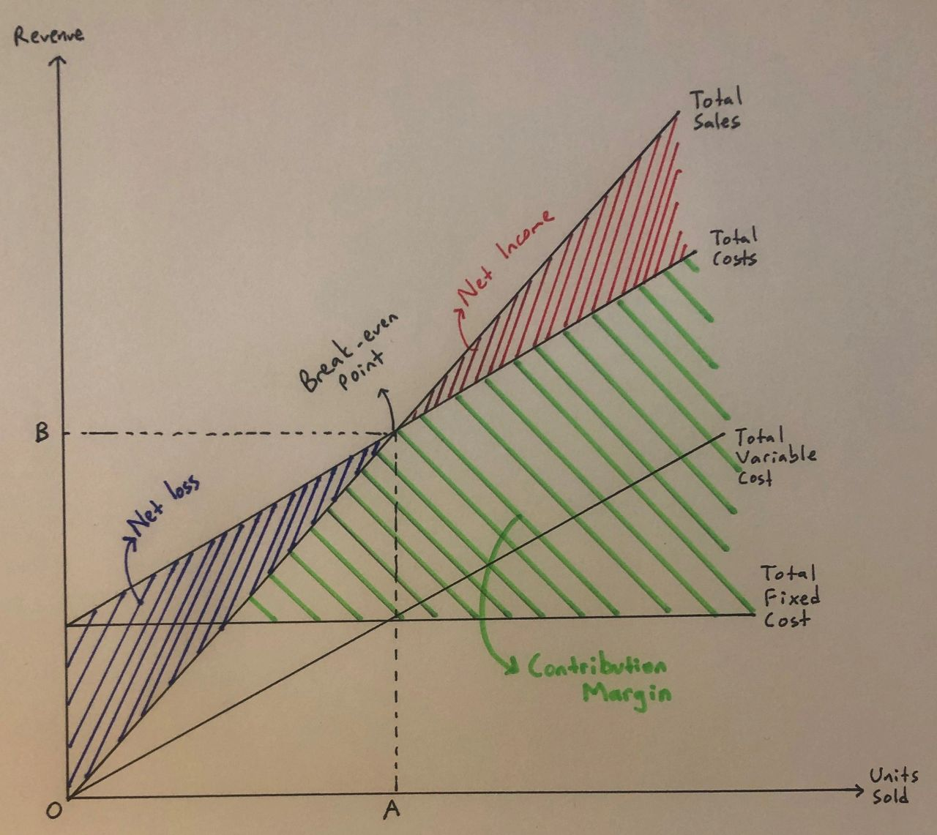

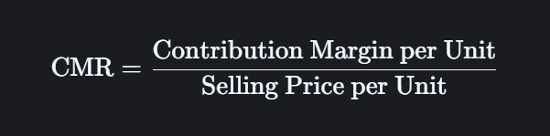
Contribution Margin: Fueling the Roadmap
The Engine of Profitability
The Contribution Margin is the revenue remaining after deducting variable costs. This amount is what "contributes" to covering fixed costs and, ultimately, generating a profit.

Slide 9


Break-Even Point Formulas
Calculating Break-Even Quantities
Break-Even Quantity (BEQ): The number of units that must be sold to cover all costs.
Break-Even Sales (BES): The total revenue required to cover all costs

Slide 10

Real Case Study – Innovative Ventures Pvt. Ltd.
The Business Challenge
Company Background
Innovative Ventures Pvt. Ltd. is a cosmetics and toiletries manufacturer serving high-income customers. The company grew by identifying gaps in the market, launching new products, and promoting them with aggressive marketing, which brought steady growth in sales and profits.
New Proposal
For a new product launch, the CEO asked for a “worst-case scenario” break-even analysis. The Finance Manager estimated the break-even at 7 lakh units, while a market survey predicted demand of 9–10 lakh units and at least 8 lakh units in the worst case. This initially made the proposal look safe and promising.
Problem
The last two product launches failed because demand was overestimated and risks were not properly assessed. This caused heavy losses and made the management more cautious about new projects.

Slide 11
The Big Mistake
Why a "Safe" Project Was Actually a Huge Risk
The financial expert, Mr. Basak, found a major problem with the initial report: it left out a huge cost.
The initial plan seemed perfect, right? The company thought that selling 7 lakh units was all it needed to break even. They felt safe because even in the worst-case scenario, they were sure they'd sell at least 8 lakh units. This confidence, however, was built on a dangerous mistake.
The plan forgot to count a major cost: the 18% return that investors expected on their Rs. 20 crore investment. Think of this as a fee the company had to pay for using that money. Ignoring this fee made their break-even number look a lot lower than it really was.
When you add that missing cost, the real break-even point isn't 7 lakh units at all—it's actually 12.54 lakh units. This is a shocking discovery because it means the company would lose money even in their best "worst-case" scenario. It shows how one small mistake can turn a seemingly safe project into a huge financial risk.

Slide 12
Key Learnings from the Case
Beyond a Single Number: The Need for a Holistic Approach
Financial Costing
Risk Exposure
Demand Uncertainty
It completely ignores the cost of capital,which is the money required to fund a project.
It doesn’t consider how market changes or unexcepted problems can affect your profits.
It assumes a fixed market demand,when in reality,demand is always changing and unpredictable.
The Innovative Ventures case study taught a valuable lesson: Traditional break-even analysis is oversimplified and risky. It's a great starting point, but it's not enough for making smart business decisions in the real world.

Slide 13
The Transition to Predictive
From Static Assumptions to Dynamic Forecasts
Traditional break-even analysis gives a single, fixed number. It's simple but dangerous, as it ignores real-world changes.
In business, prices, costs, and demand are always changing. A fixed number simply can't handle this uncertainty and risk.
Our project uses AI and machine learning to process vast, dynamic data. This lets us model real-world fluctuations.
Instead of one break-even number, our model provides a range of possible outcomes, showing what happens in different scenarios.
This gives us a future-ready, predictive financial tool that helps make more confident and strategic decisions.

Slide 14
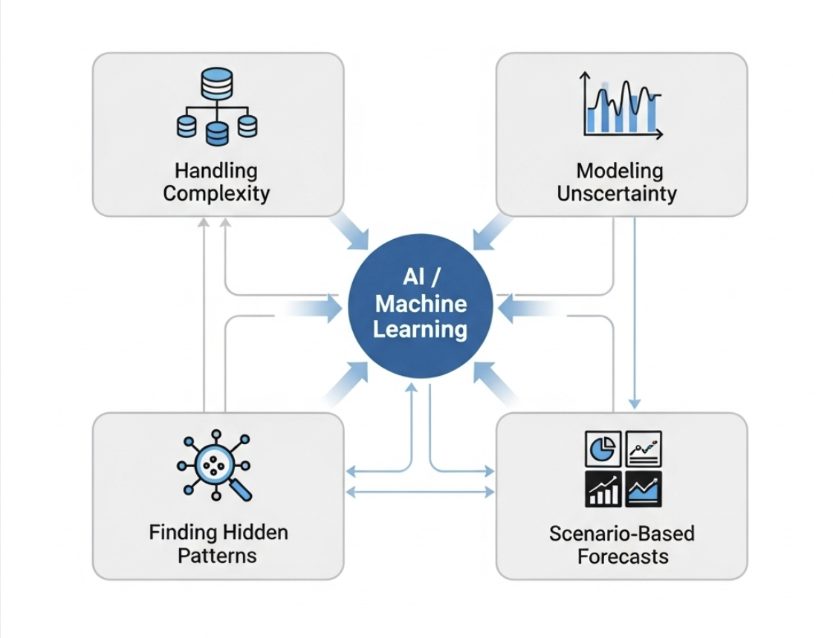
The AI Advantage
Why Machine Learning Excels at Financial Forecasting

Slide 15
Comparative Analysis
Excel vs. AI: Choosing the Right Tool for the Job
Feature | Excel | AI / ML
Method | Manual formulas, fixed inputs. | Predictive algorithms, learning from data.
Data | Static, based on what you input. | Dynamic, handles real-time and large datasets.
Output | A single break-even point. | Multiple scenario forecasts with a range of outcomes.
Flexibility | Limited; requires manual changes for each new scenario. | High; can instantly simulate hundreds of scenarios based on new data.
Best For | Simple, one-time calculations and basic understanding. | Strategic, risk-aware financial planning in complex markets.

Slide 16
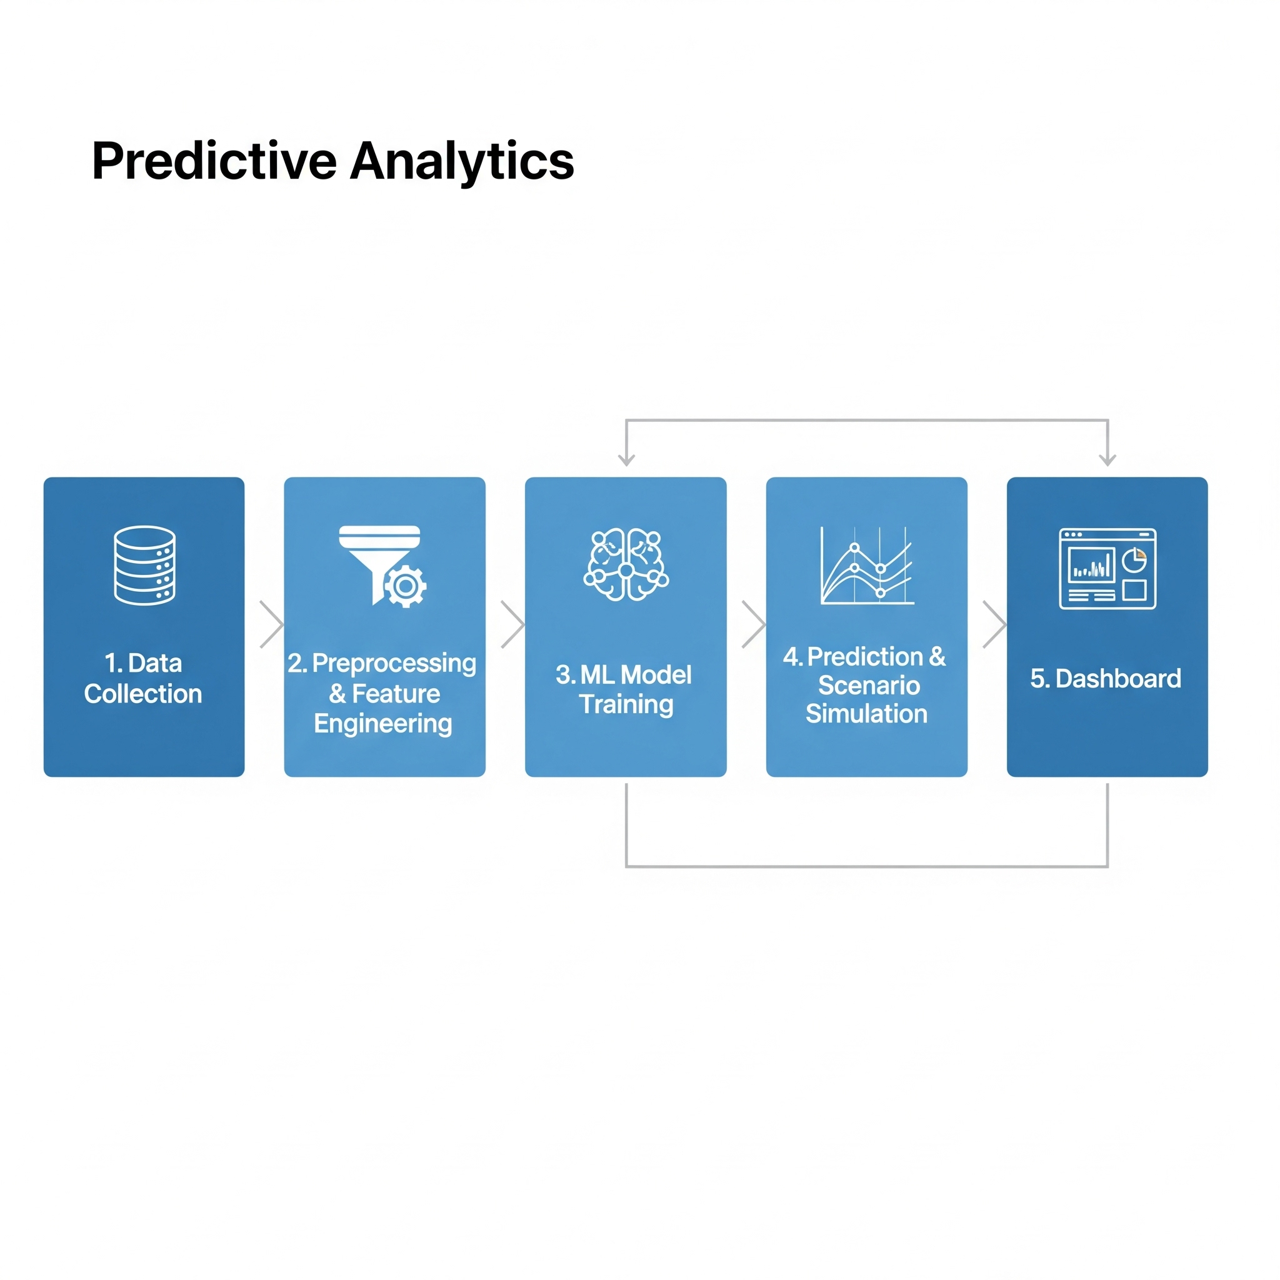
Our Predictive Analytics Workflow
The Journey from Raw Data to Strategic Insights

Slide 17
Data Inputs
Fueling the Model: What Data Drives Our Predictions?
Key Data Inputs:
1. Fixed & Variable Costs
fixed_costs – rent, salaries, utilities
variable_cost_per_unit – raw materials, commission
2. Price & Sales
price_per_unit – selling price per item
units_sold – historical sales volume
3. Performance Metrics
total_revenue – overall sales income
total_costs – sum of fixed + variable costs
profit_or_loss – financial outcome
status – classification as “Profit” or “Loss”
4. Predictive Features
marketing_spend – advertising and promotion costs
employee_count – workforce size affecting production

Slide 18
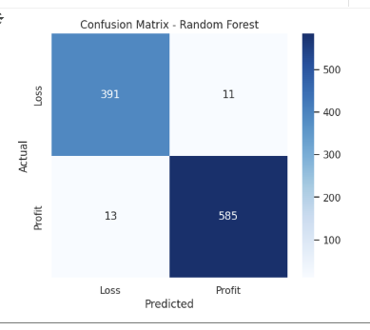
Random Forest Model
Random Forest was used as one of the predictive models for break-even analysis. It builds multiple decision trees and combines their results for more accurate predictions.
Total Test Samples
1000
Correct Predictions
976
Wrong Predictions
24
Loss predicted as Loss (True Negatives): 391 ✅
Loss predicted as Profit (False Positives): 11 ❌
Profit predicted as Loss (False Negatives): 13 ❌
Profit predicted as Profit (True Positives): 585✅
97.6%

Slide 19
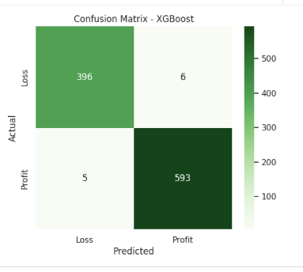
XGBoost Model
XGBoost was applied as the advanced model in our project. It uses gradient boosting to iteratively improve predictions, making it highly accurate for financial forecasting.
Total Test Samples
1059
Correct Predictions
989
Wrong Predictions
70
Loss predicted as Loss (True Negatives): 396 ✅
Loss predicted as Profit (False Positives): 5❌
Profit predicted as Loss (False Negatives): 6 ❌
Profit predicted as Profit (True Positives): 593✅
93.4%

Slide 20
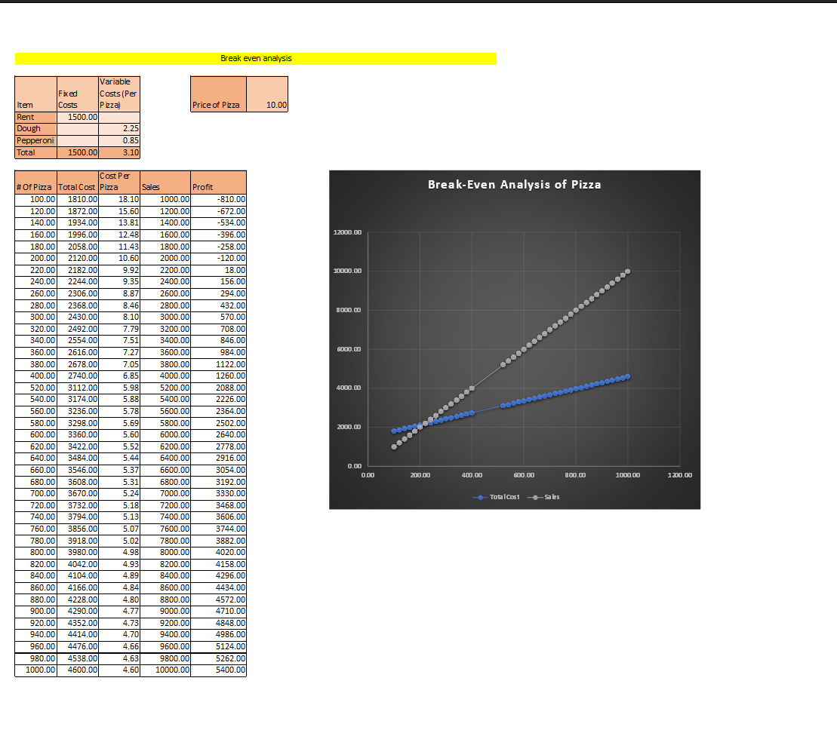
Static Break-Even Analysis – Excel Understand the traditional method and its limitations
Observations:
Break-Even Point (BEP) ≈ 220 pizzas → Profit ≈ $0
Selling less than 220 pizzas → Loss
Selling more than 220 pizzas → Profit
Static Excel model cannot adjust for changes in costs, price, or demand
Useful for basic financial planning, but limited for real-world volatility

Slide 21
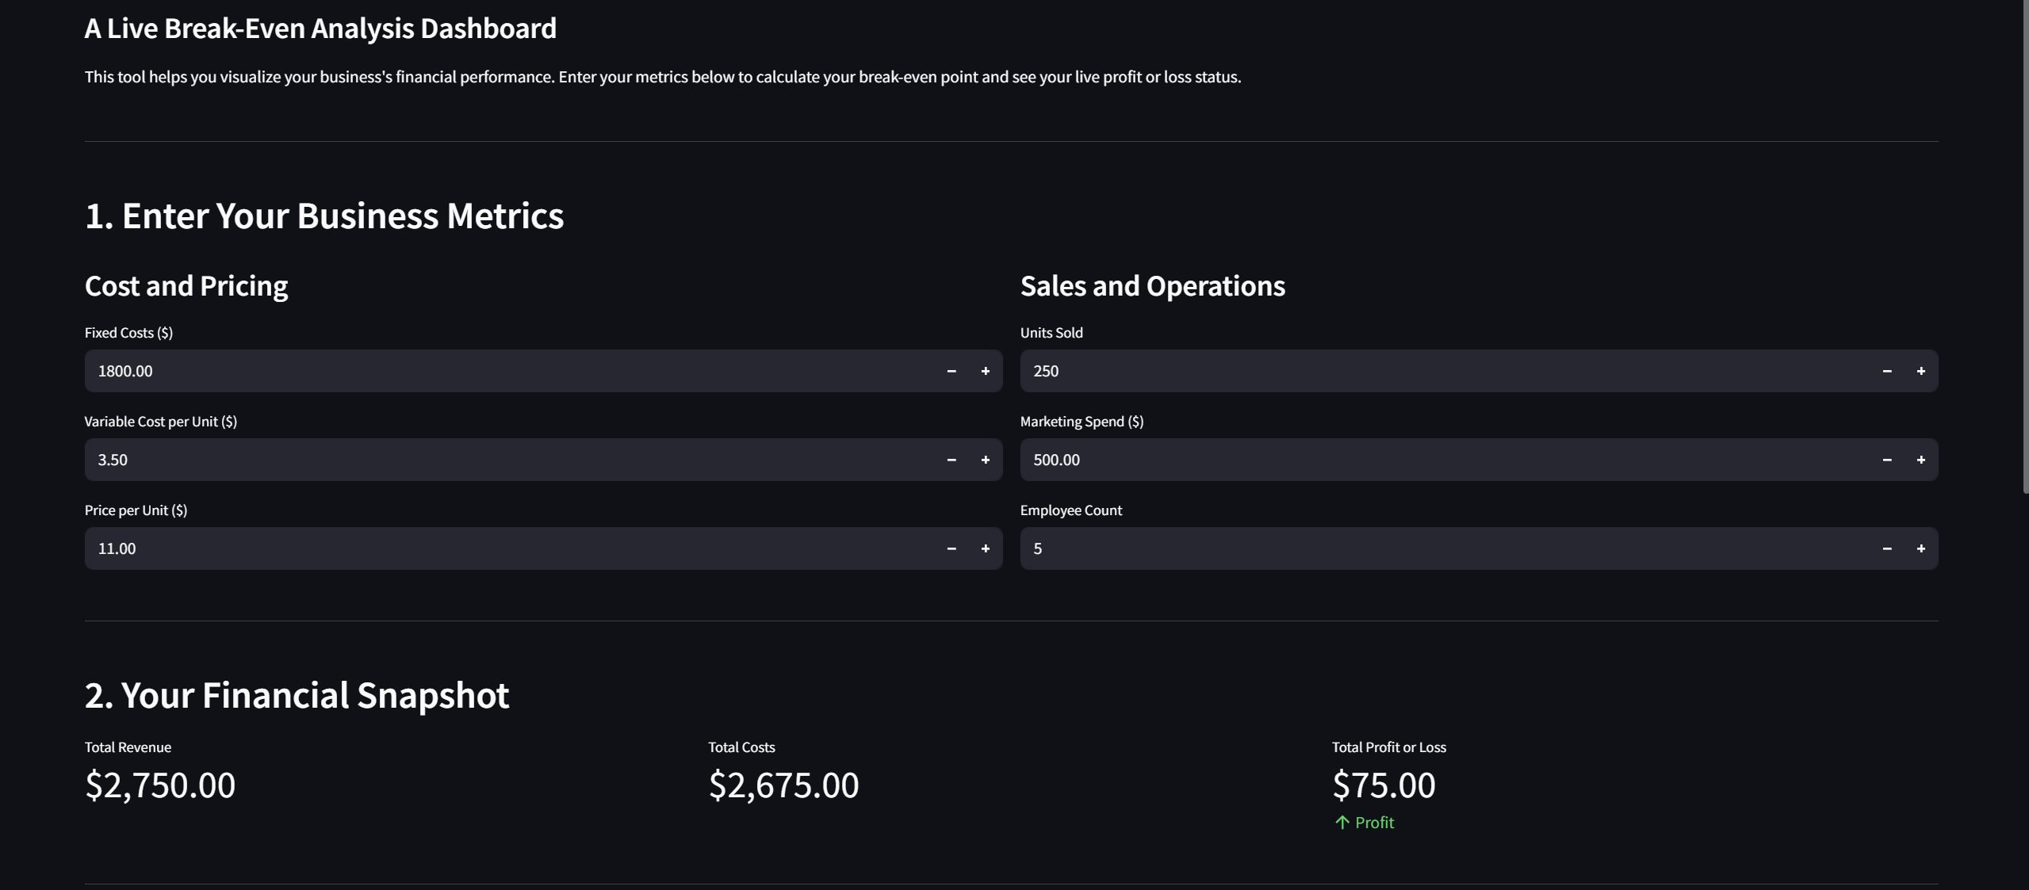
AI-Powered Break-Even – Dashboard Inputs
Enter business metrics for real-time revenue, cost, and profit calculation
Dashboard calculates Revenue,Total Costs,Profit/Loss dynamically.
Inputs : Fixed Costs,Price,Unit sold,Marketing,Employees.
Any change in the inputs updates the outputs in real time

Slide 22
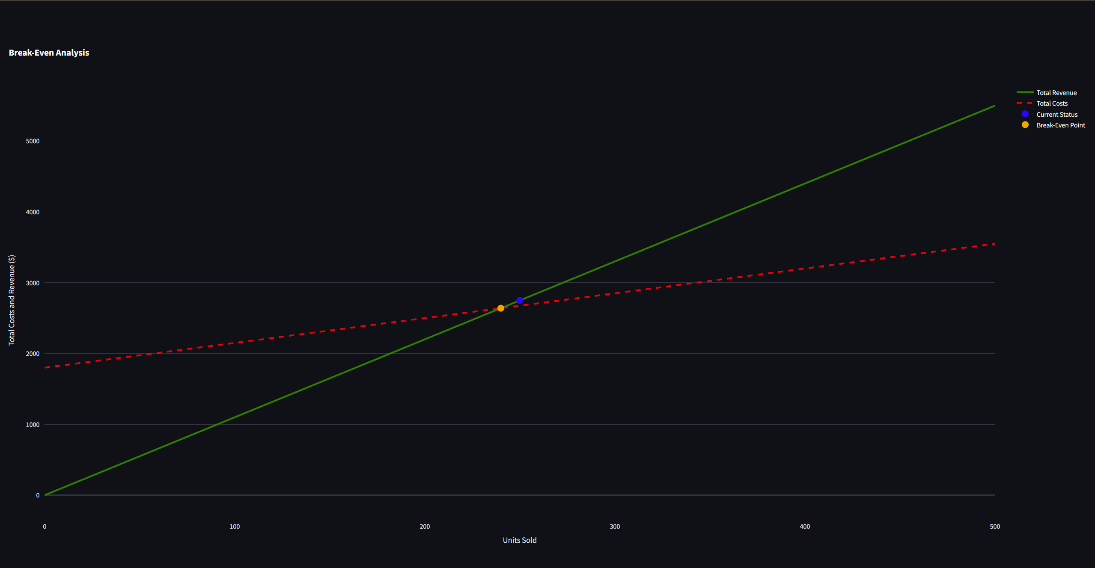
AI-Powered Break-Even – Scenario Analysis Visualize multiple break-even scenarios under changing costs and demand
Observations:
BEP ≈ 240 units → minimum to avoid loss
Current sales ≈ 250 units → business is slightly profitable.

Slide 23
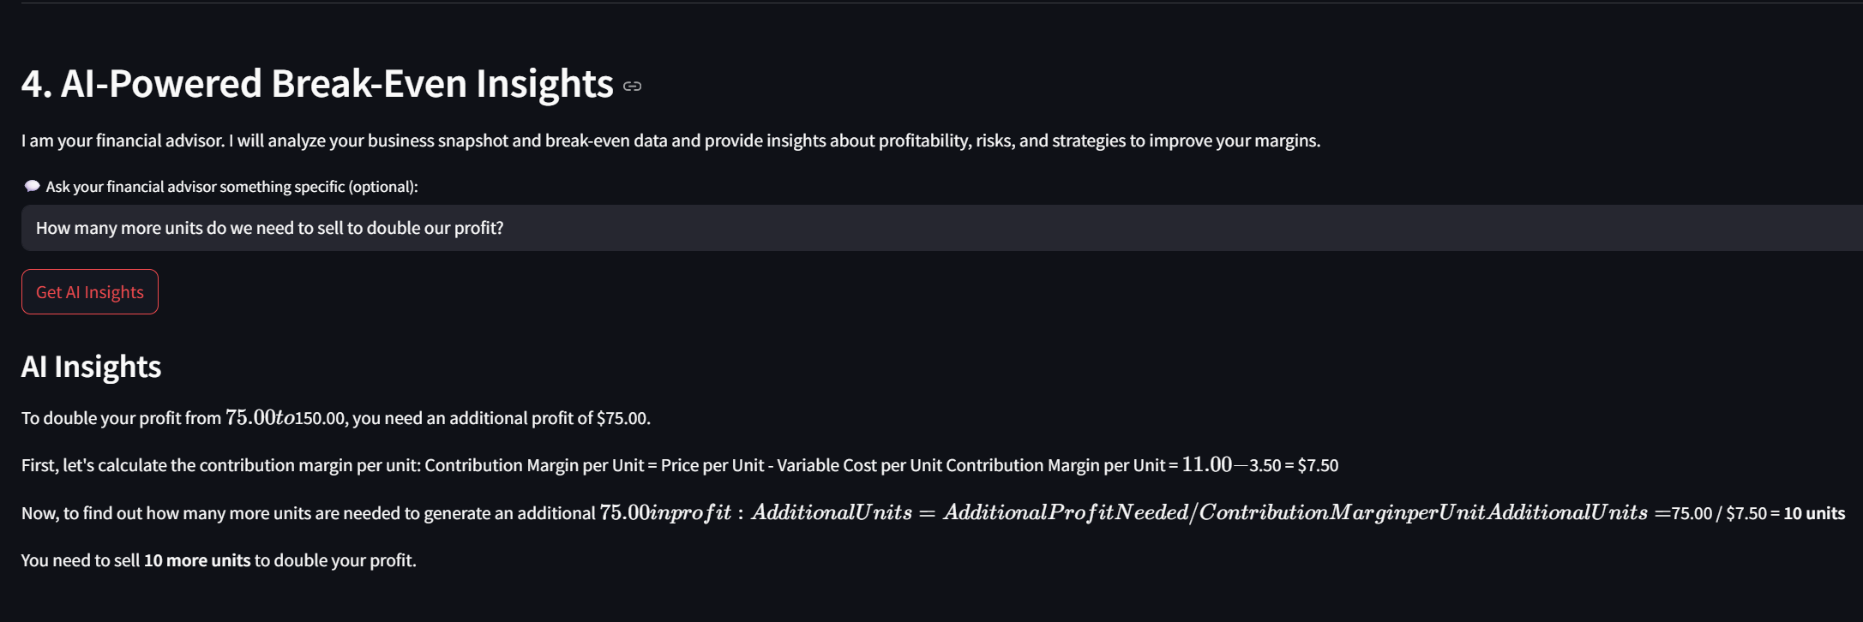
AI Insights – Actionable Recommendations
Predictive analysis for smarter financial decisions
Observation:
Current profit = $75 → goal = $150
Contribution Margin per Unit = $11 − $3.50 = $7.50
Additional units needed to double profit = 10
AI provides quick, actionable CVP analysis

Slide 24


Real-World Applications of Predictive Break-Even
How Industries Are Benefiting
Show predictive break-even and profit scenarios for better decision-making.
Adjust pricing or promotions based on sales trends to stay profitable.
Optimize fundraising and set realistic market entry targets.
Optimizing production and resource
allocation.

Slide 25
Thank You

